Slide 1
Biostatistics
Qian, Wenfeng

Slide 2
Myself
Qian, Wenfeng (钱文峰)
Institute of Genetics & Developmental Biology, CAS
Center for Molecular Systems Biology

Slide 3
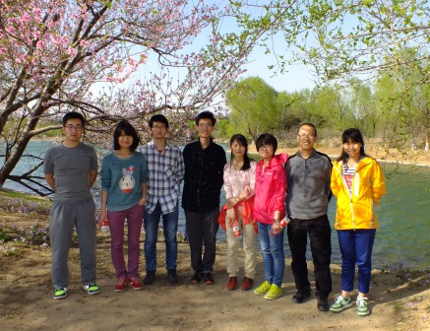
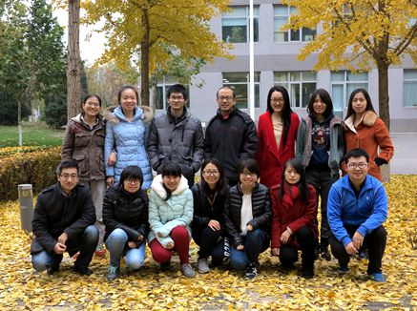
My group
http://qianlab.genetics.ac.cn/

Slide 4
My research
Single cell genetics
Variations among isogenic cells
Kinetics of gene expression
Protein synthesis/degradation
Transcriptional/translational burst
Quantitative functional genomics

Slide 5

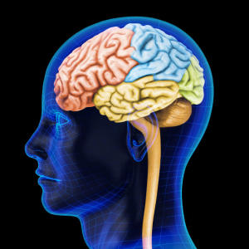
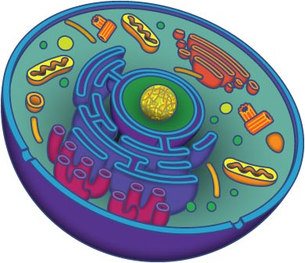
DNA coding roles
01101000 01100101
01101100 01101100
01101111 00100000
01110111 01101111
01110010 01101100
01100100
hello world
ATGCGCATATGCGCATTGCGCATATGCGCATG
………………
GCGCATATGCGCATG

Slide 6
My education
2006, B.S., Peking University
Biological Sciences
2012, Ph.D., University of Michigan
Evolutionary Genetics
Top 1% statistics among biologists

Slide 7
Course introduction
Applied biostatistics
Examples, examples, and examples
Try to make it not too heavy

Slide 8
Statistics
Statistics is the study of the collection, organization, analysis, interpretation and presentation of data.

Slide 9

Schedule
March 22: Probability
March 24: Introduction to R
March 31: Hypothesis testing
April 5: Analysis of variance
April 7: Regression and correlation
April 12: Plots with R
April 19: Presentations (+ a report = final exam)
Prof. Yang

Slide 10
R language
Standard statistical tool in science
Will be introduced by Prof. Yang
You will need to bring your laptop to the class, with R installed.

Slide 11
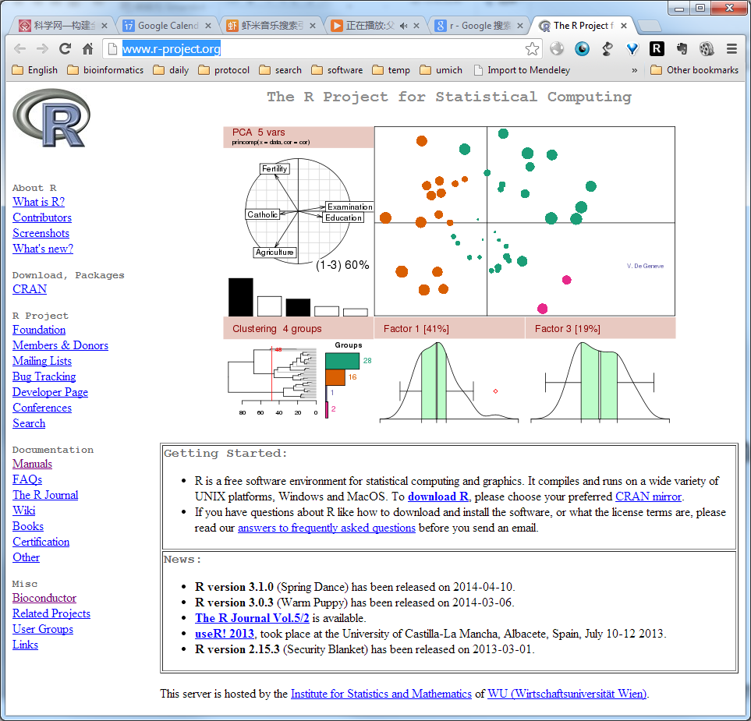
Download R
http://www.r-project.org/

Slide 12

R studio
http://www.rstudio.com/

Slide 13
Exam
Final exam is a report based on the use of statistics in a small project. The report should be 1000 - 2000 words.
Ten-minute (including 2 min Q & A) oral defense of the report in front of the class.

Slide 14
PPT
Will be uploaded to my lab website after each class
qianlab.genetics.ac.cn
Words in red: waiting for your response
Words in green: the beginning of a new example

Slide 15

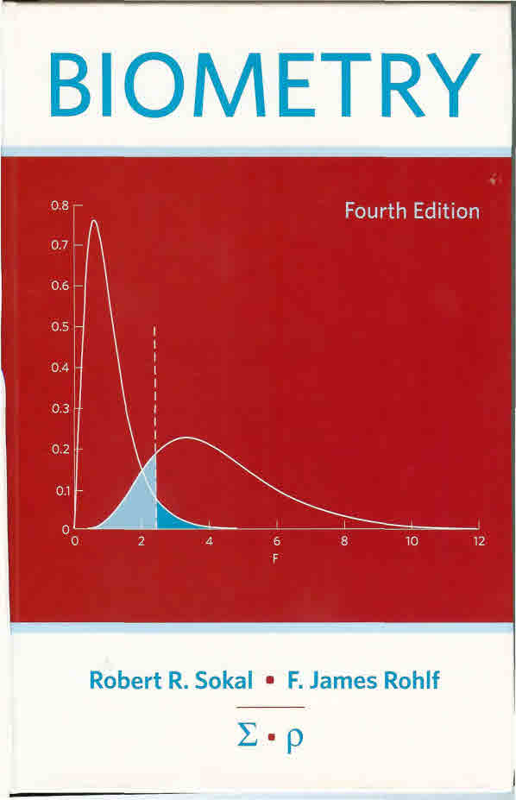
Textbook
Statistics: an introduction using R
By Michael J. Crawley
Other reference:
Biometry
by Sokal & Rohlf
What is a p-value anyway?
By Andrew Vickers

Slide 16
Your introduction

Slide 17
Statistics is the base of all sciences
The definition of the modern science?

Slide 18
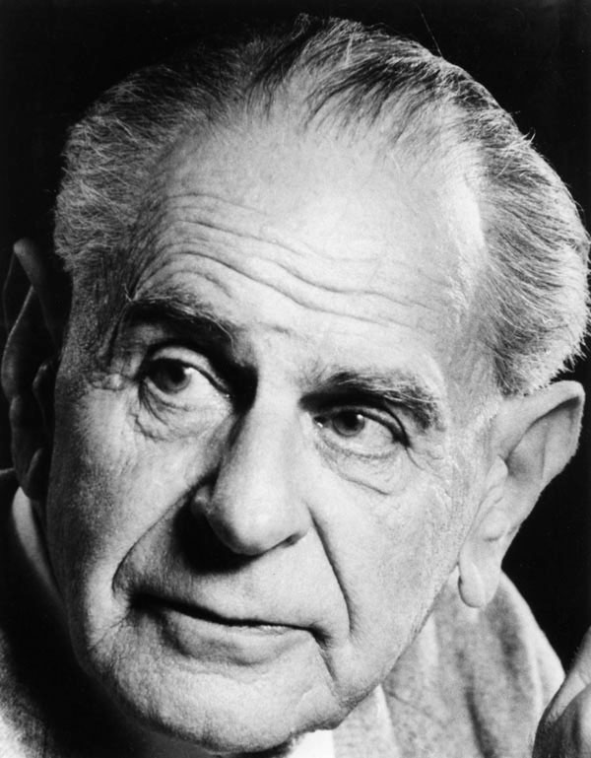
What is science?
A theory in the empirical sciences can never be proven, but it can be falsified, meaning that it can and should be scrutinized by decisive experiments.
Hypothesis testing
Karl Popper 1902-1994

Slide 19
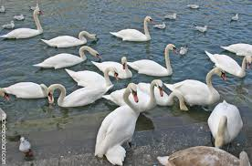
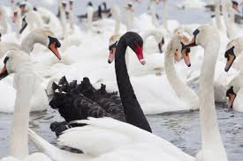
All swans are white

Slide 20
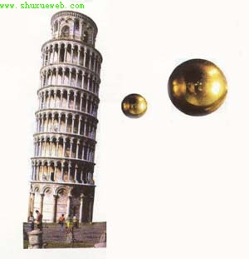
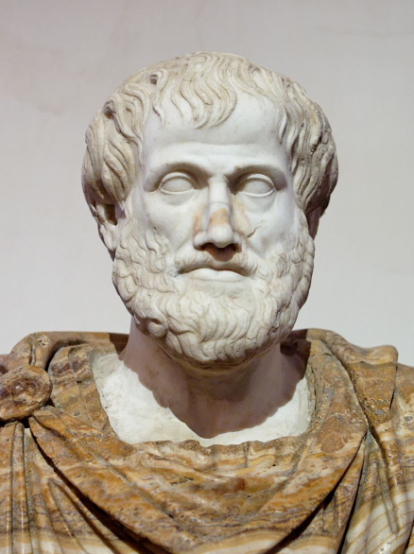
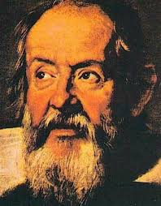
Science is about rejecting null hypothesis
Aristotle
Galilei
Leaning Tower Pisa

Slide 21
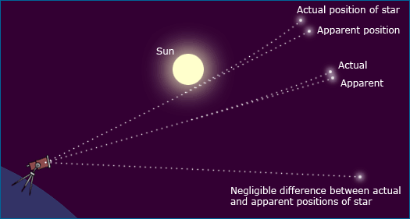
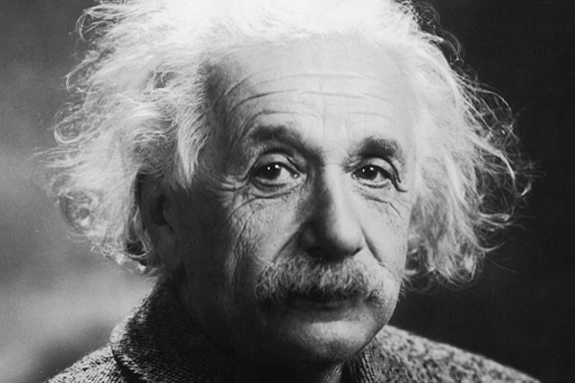
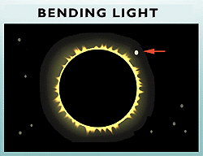
Science is about rejecting null hypothesis
Einstein
Eclipse

Slide 22
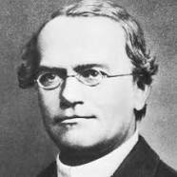
In biology
In genetics
Mixing of traits
Mendelian genetics
Two copy of genes that can be separated in the next generation, generating the 3:1 ratio
Other examples?
Mendel

Slide 23
A tale of wild south China tiger
The null hypothesis:
The wild south China tiger is extinct

Slide 24

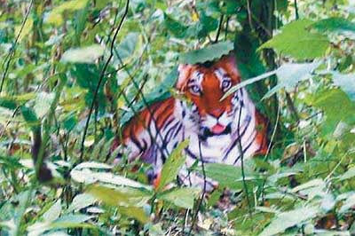
…and rejecting null hypothesis
Rejecting the null hypothesis:
The wild south China tiger is still present.
Real “dragon” Zhou

Slide 25
…and rejecting null hypothesis
The new null hypothesis:
The wild south China tiger is still present.

Slide 26

…and rejecting null hypothesis
The new null hypothesis:
The wild south China tiger is still present, which is rejected later by a poster printed earlier.

Slide 27
…and rejecting null hypothesis
The null hypothesis:
The wild south China tiger is still present, which is rejected later by a poster printed earlier.
What is the probability of the observation (the poster) given the null hypothesis (p value)?
P ≈ 0
So the null hypothesis is rejected.

Slide 28
What is a P-value?
The p-value is defined as the probability of obtaining a result equal to or "more extreme" than what was actually observed, assuming that the model is true.
P-value can be used in statistics to reject a null hypothesis
Why do we need the P-value in the first place?

Slide 29
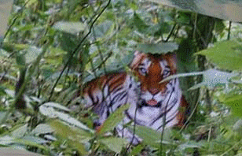
…and rejecting null hypothesis

Slide 30
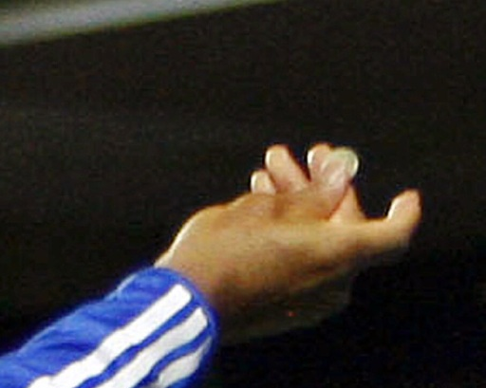
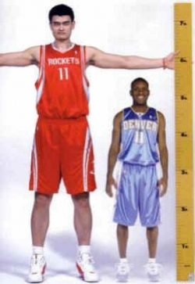

Deterministic vs stochastic events
Deterministic events
Stochastic events
If I toss a coin, I will get a face up
I will get up in the tomorrow morning
A child will grow up
Head or tail?
The exact time point (minute and second) I would wake up naturally
The height and weight of the child
Other examples?

Slide 31
Phenomena in biology
Are likely to be stochastic, compared to physical phenomena
In physical world
Sun rises
Planet moves
Water boils

Slide 32
In Biology
Weight and height
Disease
Life span
The outcome of your exam
Reason?

Slide 33
Reasons of stochasticity in life
Traits are determined by both genes and environments
Environment is heterogeneous
Most traits are affected by multiple genes
Each gene has a minor impact
Developmental strategy (body plan)
Life sciences contains a huge number of factors, which makes stochasticity everywhere.

Slide 34
Regression to the mean
In statistics, regression toward (or to) the mean is the phenomenon that if a variable is extreme on its first measurement, it will tend to be closer to the average on its second measurement
An positive gene in your screen may not appear in the next time.
The best student in the collage could become ordinary later in his/her career
Why?

Slide 35
How do we describe stochastisity?
Distribution!

Slide 36
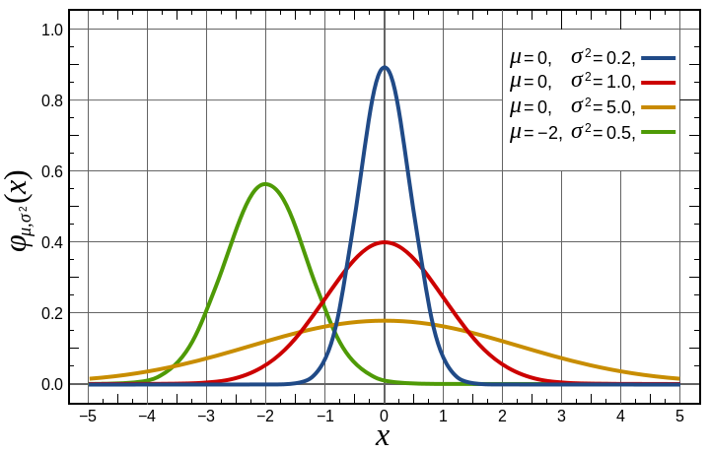
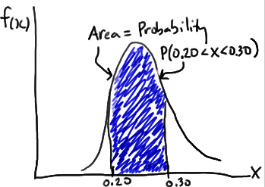
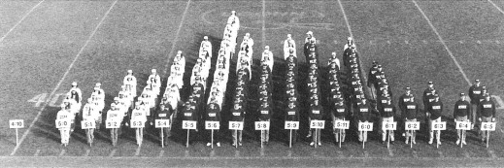
Density function

Slide 37
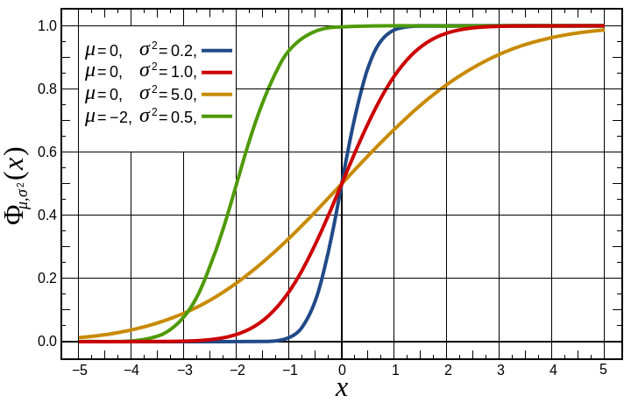
Density function
Cumulative density function

Slide 38
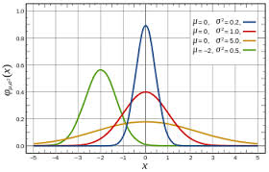
Normal distribution
The bell shape
Appears everywhere in biology
Why?
Traits are determined by both genes and environments
Many genes with minor effects
Additivity
What if not?

Slide 39
The probability of a person taller than 1.9 meter
If the distribution of height follows normal distribution, with mean = 1.75 and standard deviation = 0.06

Slide 40
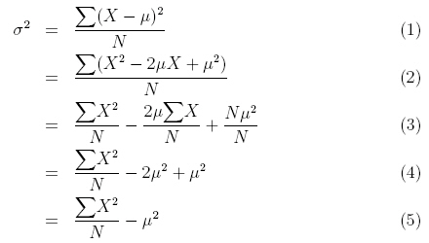
Descriptive statistics
Algebraic Mean (μ)
Variance (σ²)
Standard deviation (σ)

Slide 41
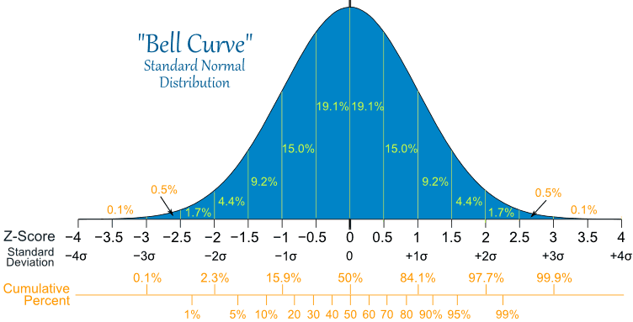
Normal distribution

Slide 42
The probability of a person taller than 1.9 meter
If the distribution of height follows normal distribution, with mean = 1.75 and standard deviation = 0.05
P = 1- “NORMDIST(1.9, 1.75, 0.05, 1)”
=0.6%

Slide 43
The height is more than 1.9 meter
If the distribution of height follows normal distribution, with mean = 1.75 and standard deviation = 0.05
What is the probability of less than 1.2 meter?

Slide 44
The height is more than 1.9 meter
If the distribution of height follows normal distribution, with mean = 1.75 and standard deviation = 0.05
What is the probability of less than 1.2 meter?
What if this number is different from your intuition?

Slide 45
The probability of a person taller than 1.9 meter
If the distribution of height follows normal distribution, with mean = 1.75 and standard deviation = 0.05
What is the probability of being between 1.7 and 1.75?

Slide 46
Can you draw
A density curve of standard normal distribution in Excel?
A cumulative density curve of standard normal distribution in Excel?

Slide 47
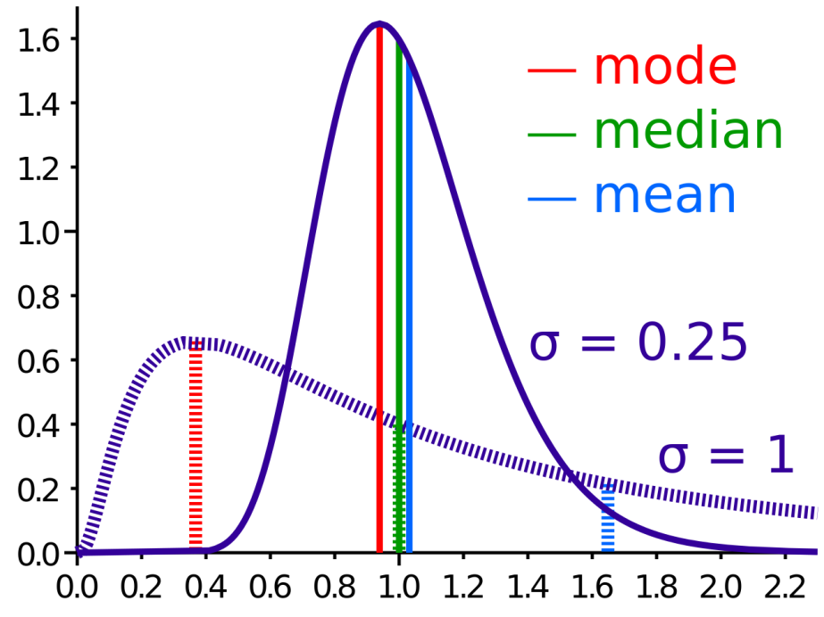
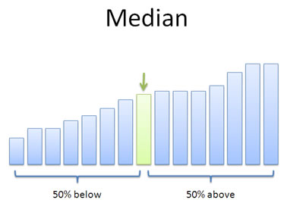
Bill Gates’ visit to a bar
Median

Slide 48
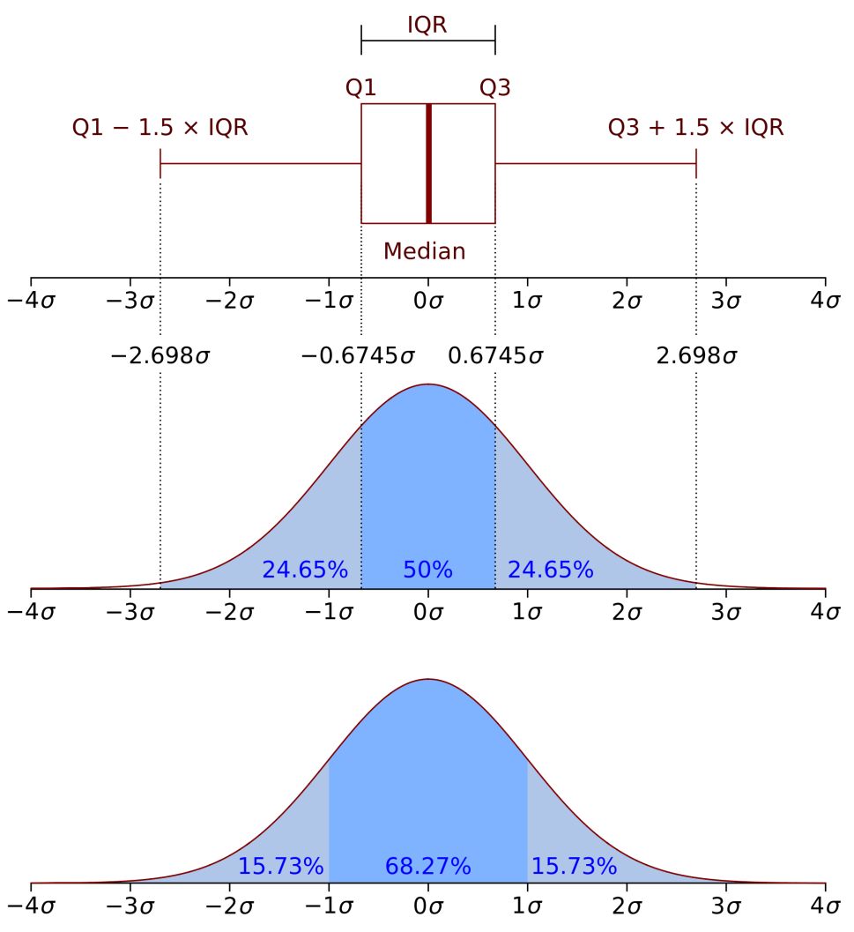
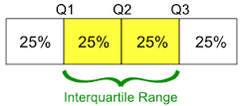
Bill Gates’ revisit to the bar
Boxplot
Interquartile range

Slide 49
How do we treat stochastic data
At a summer tea party in Cambridge, England, a guest states that tea poured into milk tastes different from milk poured into tea. Her notion is shouted down by the scientific minds of the group.
But one man, Ronald Fisher, proposes to scientifically test the hypothesis.

Slide 50

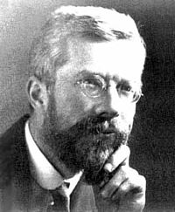

Slide 51
How to test the hypothesis?
H₀: There is not difference on order of milk and tea

Slide 52
How to test the hypothesis?
H₀: There is not difference on order or milk and tea
10 cups of drink
Mixed blind to the lady
Let the lady tell the order of milk and tea
If H₀ is correct, what is the probability the lady get all 10 guess correct?

Slide 53
How to test the hypothesis?
If H₀ is correct, what is the probability that the lady got all 10 guesses correct?

Slide 54
How to test the hypothesis?
If H₀ is correct, what is the probability the lady get all 10 guesses correct? 0.1%
It is unlikely that event with such low probability happened in a single test. Thus, the most likely scenario is that H₀ is incorrect, and there is difference between two orders.

Slide 55
What if…
Among 10 tests, the lady succeeded for 8 of them?

Slide 56
Binomial distribution
First child, Boy or Girl
Second, B or G
Third, B or G
Eight possibilities:
BBB, BBG, BGB, BGG, GBB, GBG, GGB, GGG
What is the probability of having 2 B in 3 children?

Slide 57
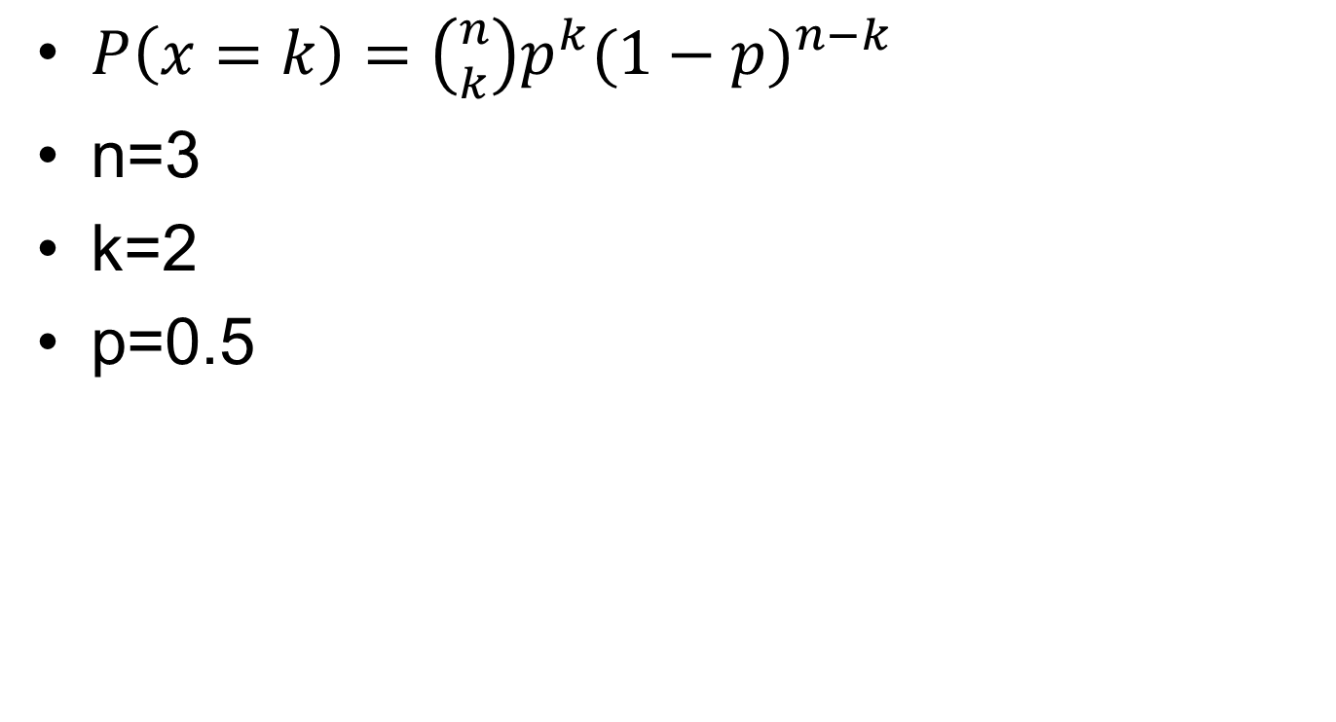
Binomial distribution
$P\left(x=k\right)=\left({n \atop k}\right)p^{k}{(1−p)}^{n−k}$
n=3
k=2
p=0.5

Slide 58
What if…
Among 10 tests, the lady succeeded for 8 of them?
What is the p-value?

Slide 59
Probability estimation
Alternatively, we can estimate the probability of success (E)
In this case 80%
We can get 95% confidence interval (CI)
If 0.5 is out of CI, we conclude a difference between the order

Slide 60
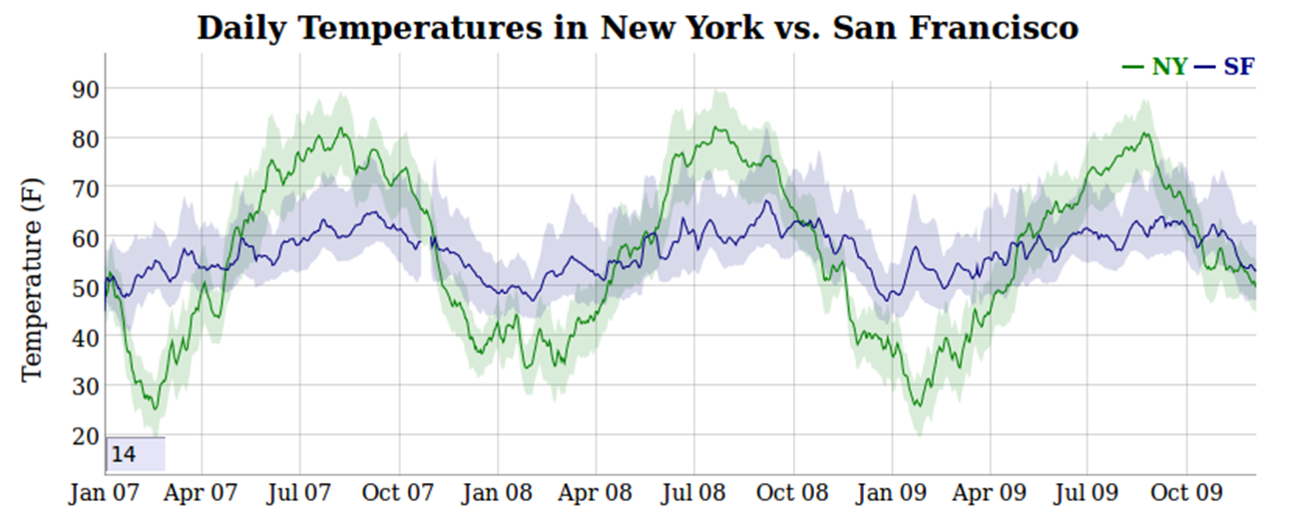
Confidence interval

Slide 61
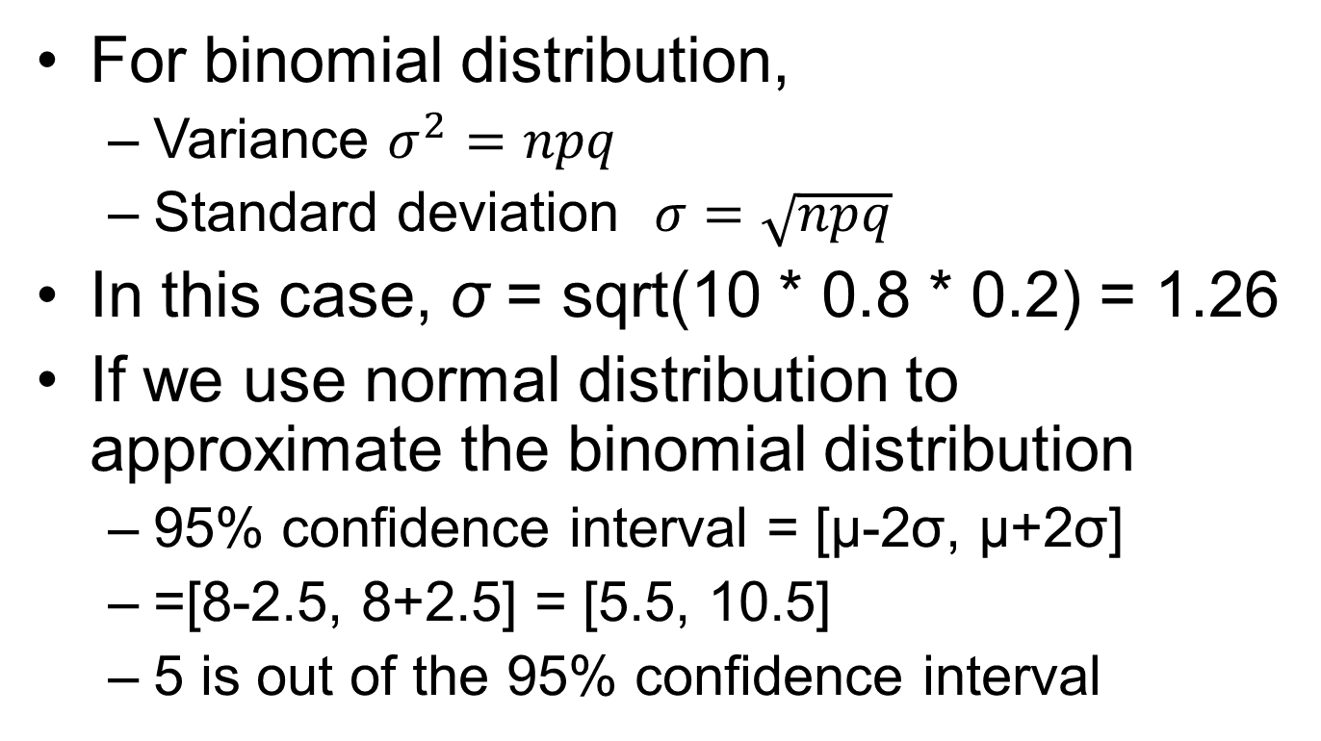
How to calculate confidence interval?
For binomial distribution,
Variance $σ^{2}=npq$
Standard deviation $σ=\sqrt{npq}$
In this case, σ = sqrt(10 * 0.8 * 0.2) = 1.26
If we use normal distribution to approximate the binomial distribution
95% confidence interval = [μ-2σ, μ+2σ]
=[8-2.5, 8+2.5] = [5.5, 10.5]
5 is out of the 95% confidence interval

Slide 62
Law of large number
The estimate of the probability 0.8 may not be accurate …
The larger the sample size, the more accurate our estimate is.
So that we could potentially distinguish 50% from 60%

Slide 63
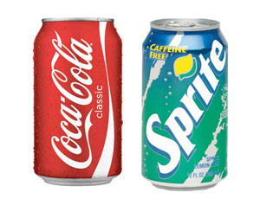
Applications of such idea
Hold your nose, and you may not be able to tell coke from sprite

Slide 64
Is a drug effective or not?
Other examples?

Slide 65
Number of left handed people
If the probability of left handed people is 5% in a population, what is the probability of a 50-student class containing exact 1 left handed people?

Slide 66
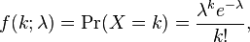
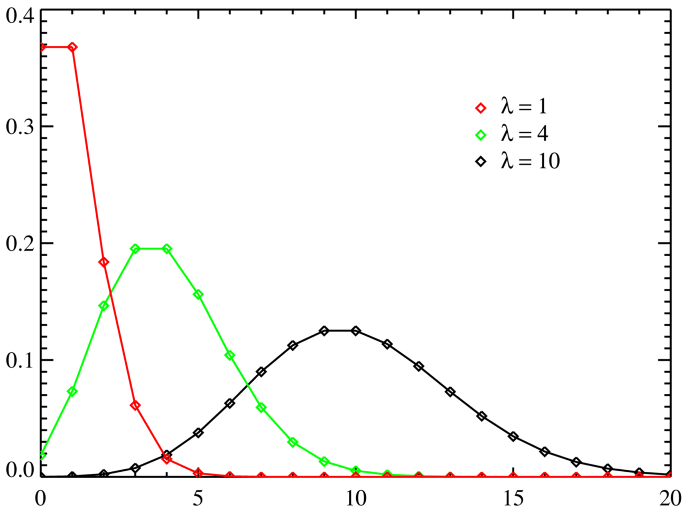
Poisson distribution
λ = mean = variance

Slide 67
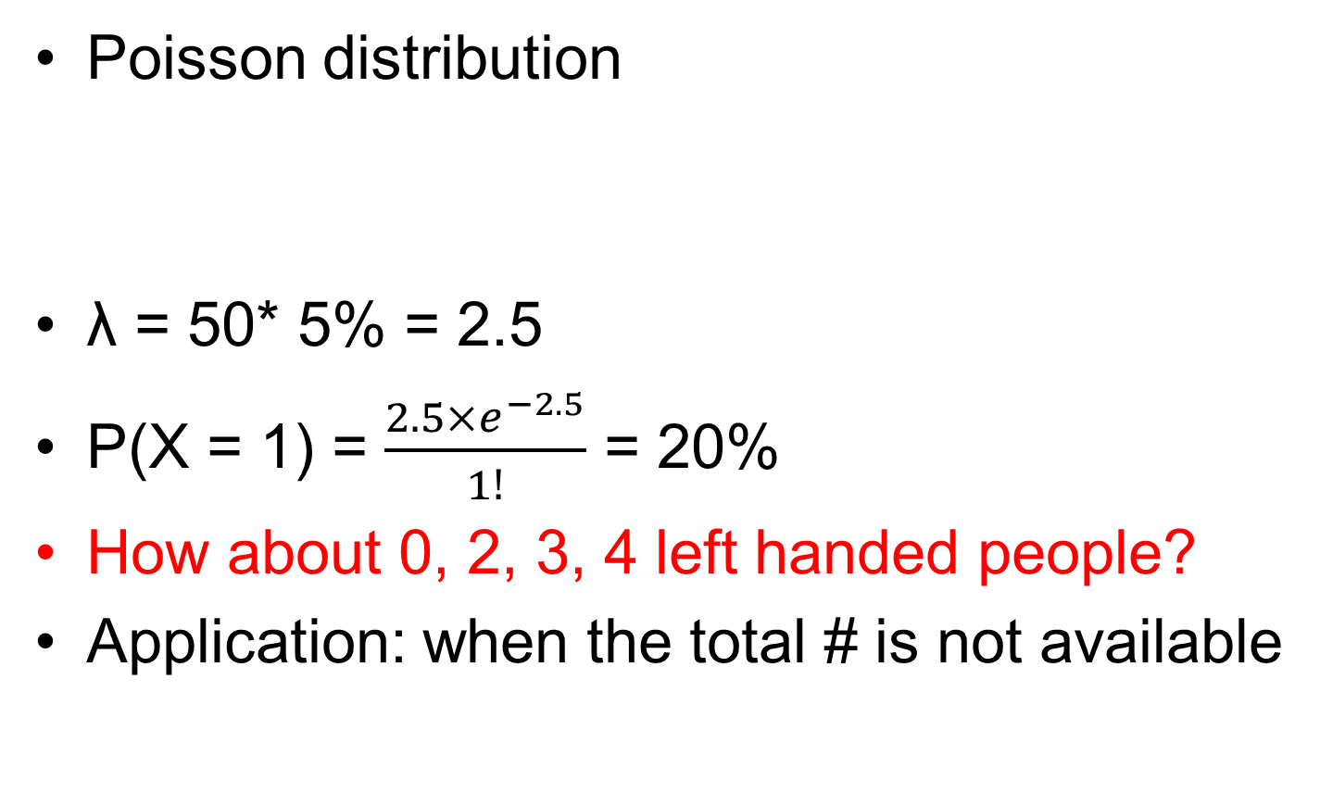
Number of left handed people
Poisson distribution
λ = 50* 5% = 2.5
P(X = 1) = $\frac{2.5×e^{−2.5}}{1!}$ = 20%
How about 0, 2, 3, 4 left handed people?
Application: when the total # is not available

Slide 68
Uranium(²³⁵U)’ radiation
Neutron
Rate 1/sec
The probability of having exactly 1 radiation event in the next sec?

Slide 69
Luria-Delbrück experiment
Question: Did the mutation to resistance happen
BECAUSE of the presence of a virus, or even
BEFORE adding the virus to the culture?

Slide 70
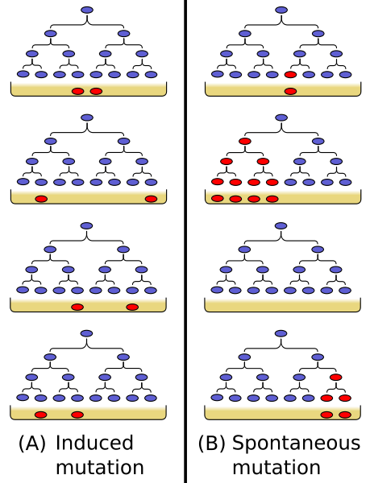

Slide 71
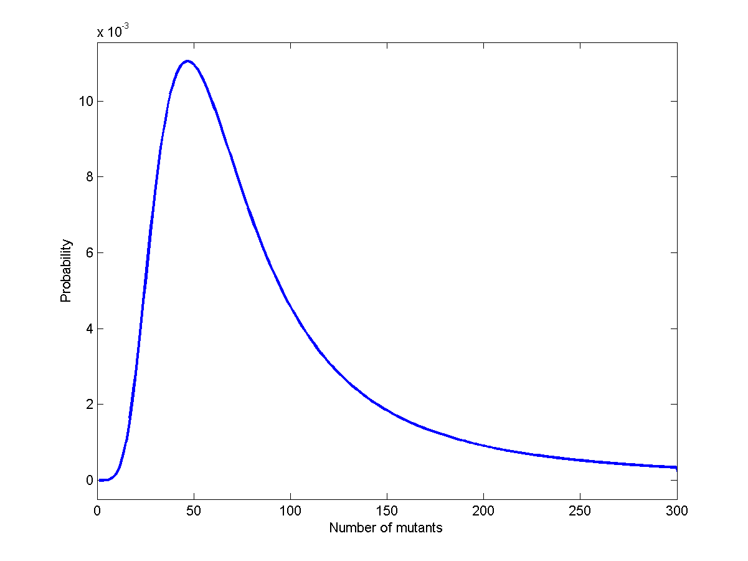

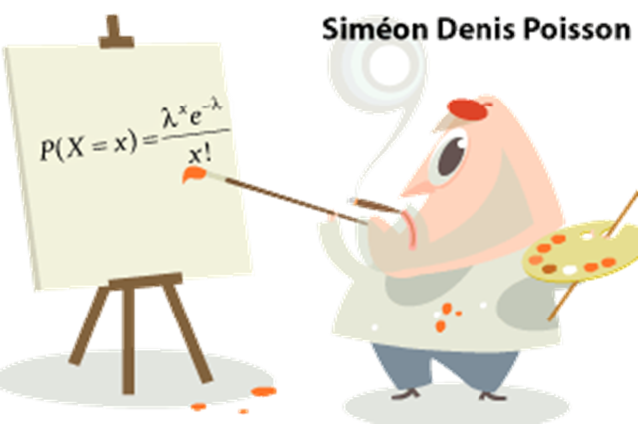
Poisson distribution
Luria-Delbrück distribution

Slide 72
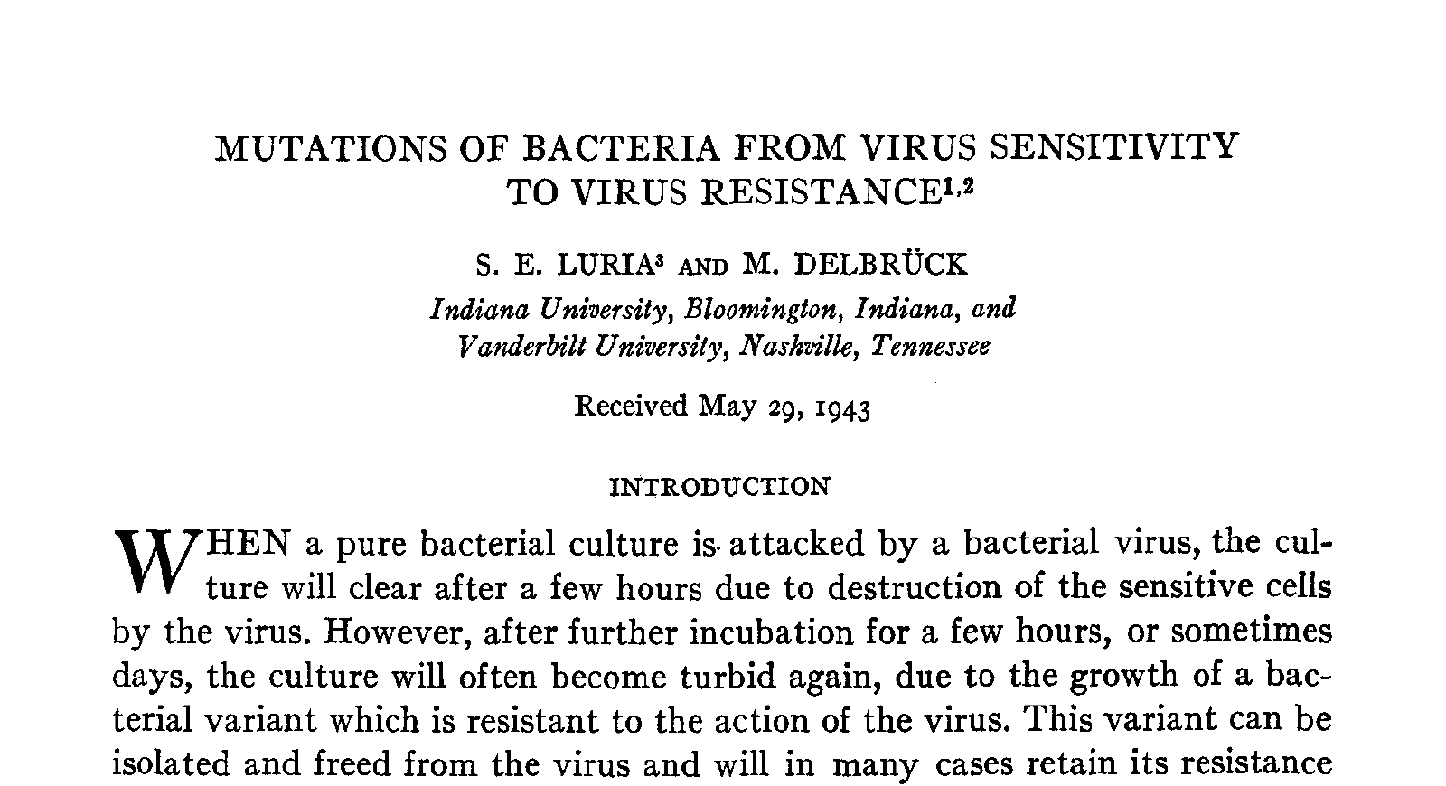

Slide 73
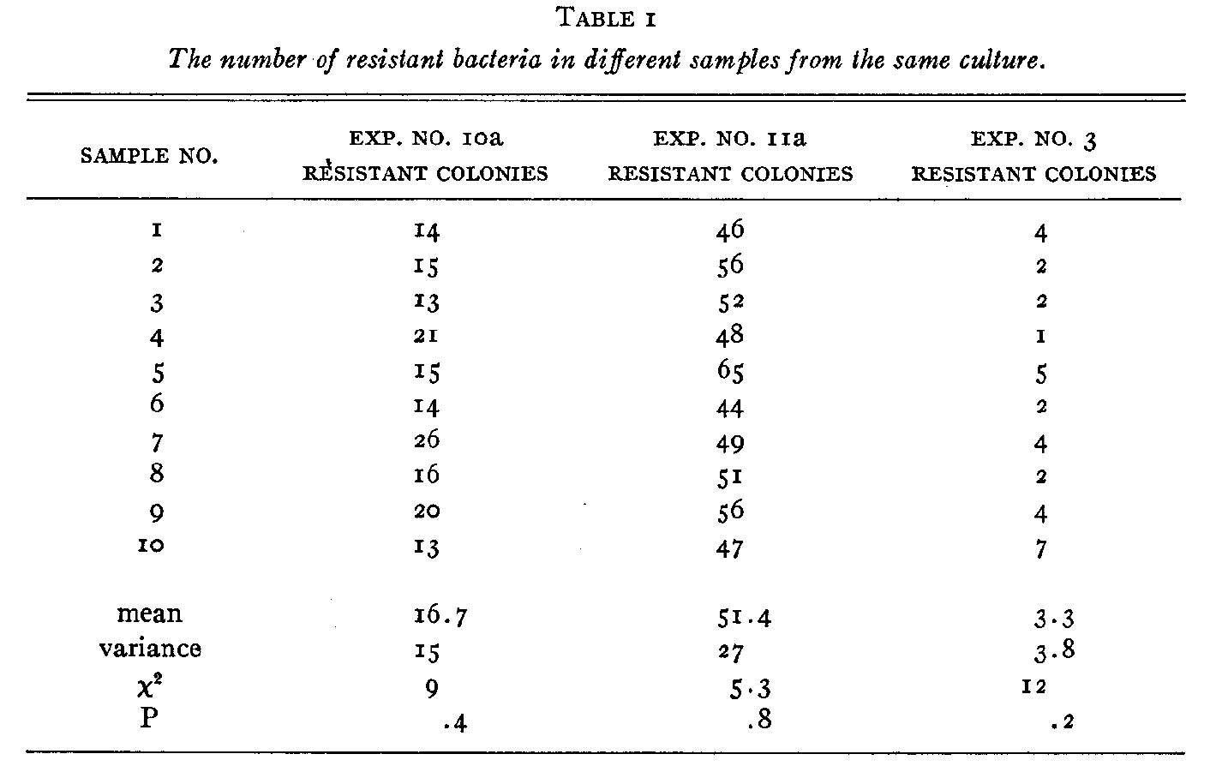

Slide 74
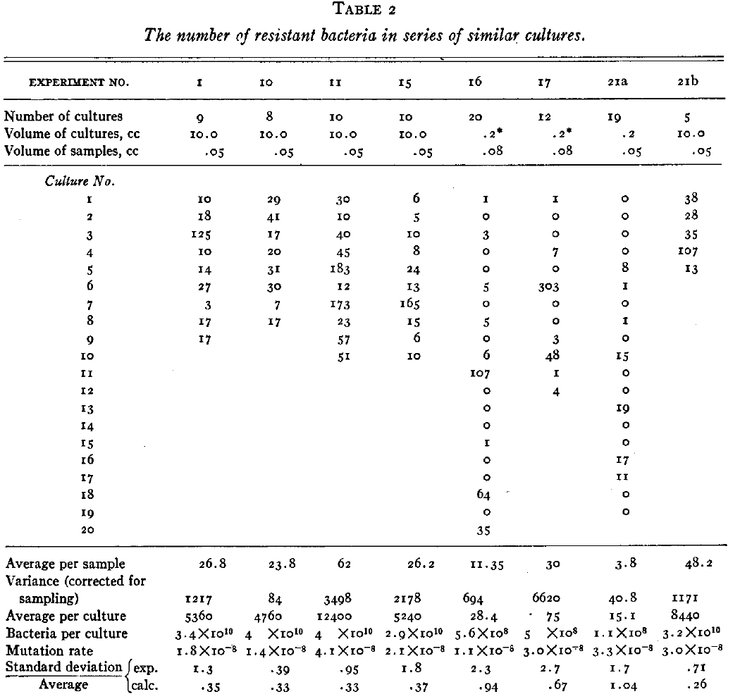

Slide 75
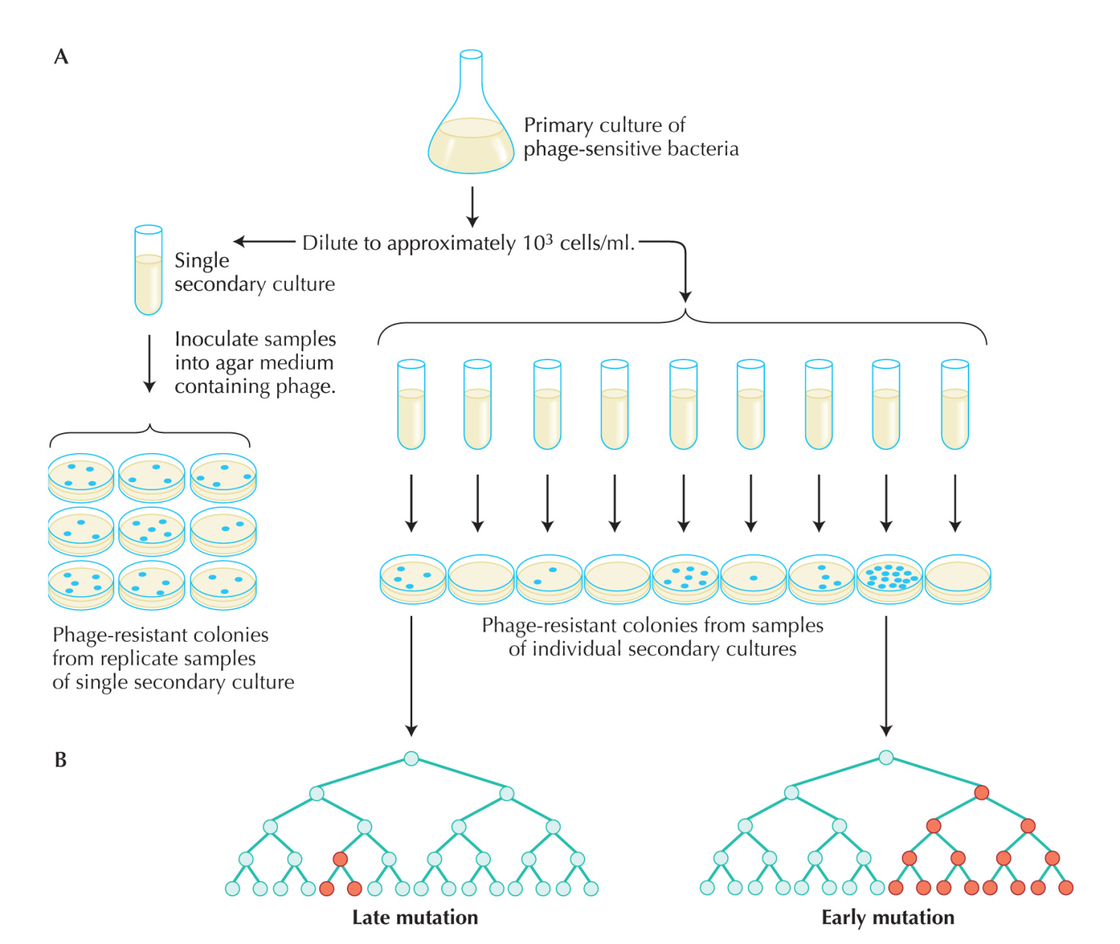
Luria-Delbrück experiment

Slide 76
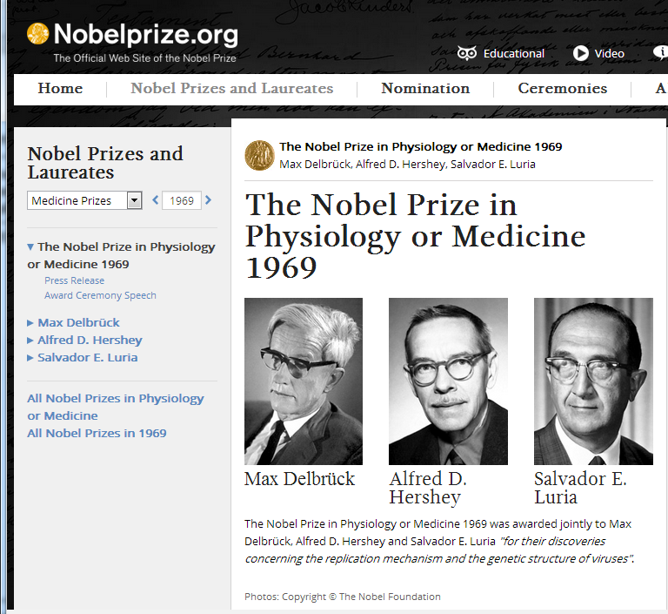

Slide 77
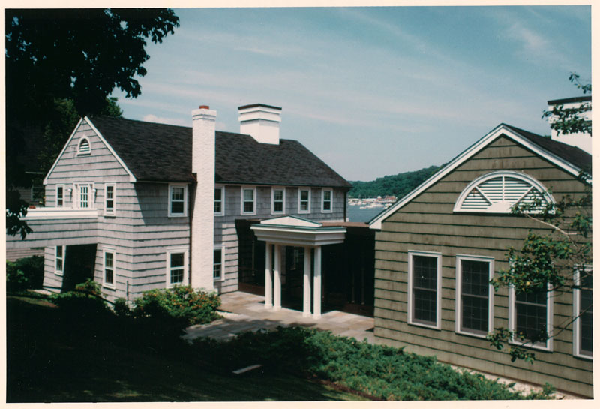


Slide 78
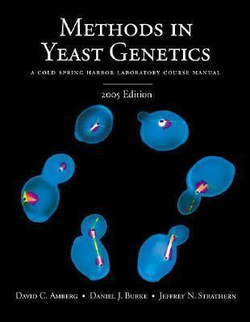
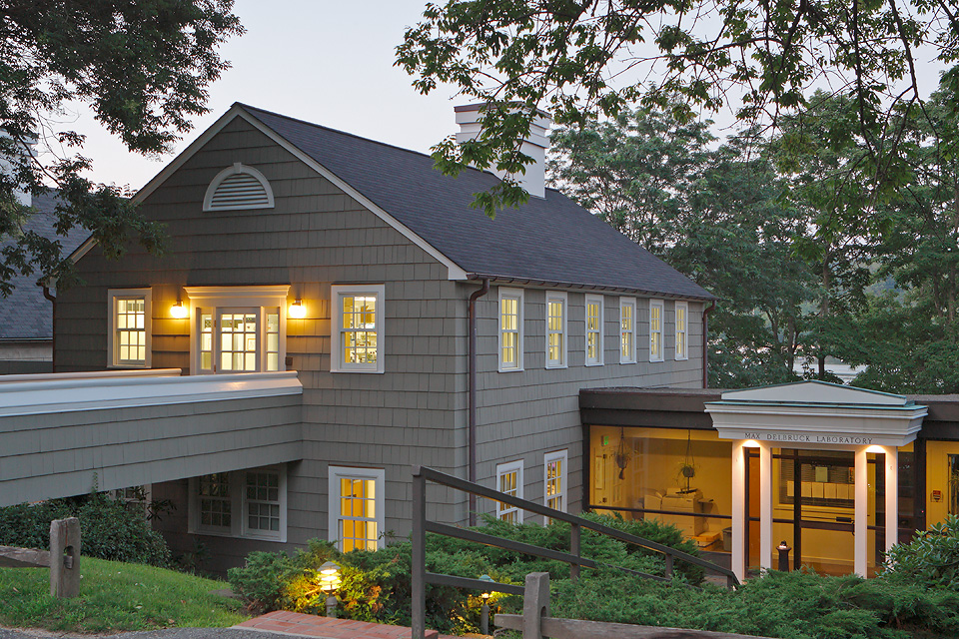

Slide 79
Intuition is extremely important in statistics

Slide 80



Blaise Pascal
1623-1662
Pascal's principle

Slide 81
Geek’s joke
One day, Einstein, Newton, and Pascal meet up and decide to play a game of hide and seek. Einstein volunteered to be “It.” As Einstein counted, eyes closed, to 100, Pascal ran away and hid, but Newton stood right in front of Einstein and drew a one meter by one meter square on the floor around himself. When Einstein opened his eyes, he immediately saw Newton and said “I found you Newton,” but Newton replied,

Slide 82
Einstein, Newton, and Pascal Play Hide and Seek
“No, you found one Newton per square meter. You found Pascal!”.

Slide 83

Pascal’s Problem
The rule of the game
Two people toss the coin one by one
Player A wins when s/he gets 3 “head”
Player B wins when s/he gets 3 “tail”
The game has to stop when A gets 2 “head” and B gets 1 “tail” because of King’s call
How to split the bet?

Slide 84
Opinions
B: A gets 2/3 and B gets 1/3
A needs one more “head”, P = 1/2
B needs two more “tails”, P = 1/4
A: A gets 3/4 and B gets 1/4
B wins only when B gets two “tails” P = 1/4
Otherwise, A wins P = 3/4
Who is correct?

Slide 85
Conclusion
A: A gets 3/4 and B gets 1/4

Slide 86

Monty Hall problem
Suppose you're on a game show, and you're given the choice of three doors: Behind one door is a car; behind the others, goats. You pick a door, say No. 1, and the host, who knows what's behind the doors, opens another door, say No. 3, which has a goat. He then says to you, "Do you want to pick door No. 2?" Is it to your advantage to switch your choice?
Your guess?

Slide 87
Monty Hall problem
If the car is not behind door 3, the probabilities of being behind door 1 and door 2 are equal
P = ½ for both.

Slide 88







Solution 1
1/3
1/3
1/3

Slide 89


Solution 2

Slide 90
Intuition: Consider 10000 doors …
You chose door 1
The host open 9998 doors for you, and none of them have cars behind
Do you switch?

Slide 91
Monty Hall problem
Switch it!

Slide 92
The probability of the same birthday in a class
Consider a class with 50 people
What is the probability that at least two students have the same birthday?
Your guess?

Slide 93
The probability that all have different birthday
The first person: 1
The second person: 364/365
The third person: 363/365
…
The 50th person: 316/365
P = 0.03

Slide 94
The answer
The probability that all have different birthdays
P = 0.03
The probability that at least two students have the same birthday
1 – P =0.97

Slide 95
The success of an experiment
Two people A and B are doing an experiment in my lab
According to the history records, the successful rate for A is 0.8, and that for B is 0.7
Each of them does the experiment once
What is the probability of at least one success?

Slide 96
The success of an experiment
Consider the probability both of them fail
P = 1- 0.2 * 0.3 = 0.94

Slide 97
The success of an experiment
Consider the probability both of them fail
P = 1- 0.2 * 0.3 = 0.94
Any problems here?

Slide 98
The success of an experiment
Consider the probability both of them fail
P = 1- 0.2 * 0.3 = 0.94
Any problems here?
It depends on whether the two people are doing experiments independently!
Do they use the same set of reagents?
If true, then A’s failure increases the probability of B’s failure

Slide 99
The conditional probability
P(A|B)
The probability of A given B
The probability of girl given the first child is a boy in the family
P(the second child is a girl | the first child is a boy)
If independent P (2nd girl | 1st boy) = P (girl)

Slide 100
Probability of infection
A test can detect 95% of the people with infection (true positive)
There is 1% probability of false positive
The frequency of a infection is 0.5%
What is the probability of infection, given a positive result in the test

Slide 101



Bayesian theorem
$P\left(A_{i} \right| B)= \frac{P\left(A_{i}\right)P\left(B \right| A_{i})}{\sum_{i=1}^{∞}{P\left(A_{i}\right)P\left(B \right| A_{i})}}$
A_{i} = infected
B = positive in the test
P (A_{i} | B)

Slide 102
Autosomal single-locus disease
Patients
Normal individuals
?

Slide 103
Autosomal single-locus disease
Patients
Normal individuals
?

Slide 104
The probability of 4th girl in the family, given the first 3 are all girls
Your opinion?

Slide 105
Genetics or stochasticity
Model I: for some genetic reasons, only sperms with X chromosome survive.
Model II: the birth of sons and daughters are equally likely
For a family with 3 daughters, which model is more likely?

Slide 106
Genetics or stochasticity
Model I: for some genetic reasons, only sperms with X chromosome survive.
Model II: the birth of sons and daughters are equally likely
How to calculate it quantitatively?

Slide 107
Genetics or stochasticity
Model I: for some genetic reasons, only sperms with X chromosome survive.
Model II: the birth of sons and daughters are equally likely
LOD score: log₁₀ of odds
LOD = log₁₀(P(obs. | model I)/ P(obs. | model II))

Slide 108
Genetics or stochasticity
Model I: Genetics
Model II: By chance
LOD = log₁₀(P(obs. | model I)/ P(obs. | model II))
P(obs. | model I) = 1
P(obs. | model II) = 1/8
LOD =log₁₀(1/8) = -0.9
Threshold: >3 or <-3

